Slide 1

Exam AZ-301-304: Microsoft Azure Architect Design Crash Course
Tim Warner

Slide 2


Tim Warner
Based in Nashville, TN, US
Central time zone
MCT, MVP
Twitter: @TechTrainerTim
Badge: TechTrainerTim.com

Slide 3
Course Materials
timw.info/az301

Slide 4
Session 1 of 2 Learning Goals
Design Monitoring
Design Identity and Security
Design Data Storage
Design Business Continuity

Slide 5
Session 2 of 2 Learning Goals
Design Migration
Design Infrastructure
Design Application Architecture
Exam AZ-301-304 certification strategy

Slide 6
Setting Expectations
Azure Architect is an expert-level certification
You should already know how to deploy and configure Azure resources
This is a "crash course"
Please plan to review these materials more than once
Five-minute break at midpoint
Please ask/answer questions and provide feedback in the Q/A panel, not the group chat

Slide 7
2020 Exam Update Information
Microsoft Worldwide Learning (WWL) revisits the Azure role-based certs yearly
Relevant blog post: timw.info/az2020
Changes:
AZ-300 replaced with AZ-303
AZ-301 replaced with AZ-304
AZ-304 beta is available now
AZ-301 retires around September 30, 2020

Slide 8
2020 Exam Update Information
You can earn your badge by combining the old and new exam versions:
AZ-300 and AZ-304
AZ-301 and AZ-303
The certification is the same, and has a 2-year expiry

Slide 9
Tim's Certification Study Pyramid
Interdependence
Content knowledge
Practical application
Test-taking skills

Slide 10
Identity Design

Slide 11

Azure AD SSO
henry.a.miller@companycom.onmicrosoft.com
Cl0udpa$$111!
Henry-miller@company.com
myPa$$w0rd122!

Slide 12
Azure AD SSO
Henry-miller@company.com
myPa$$w0rd122!
Henry-miller@company.com
myPa$$w0rd122!

Slide 13

AD FS Federation

Slide 14


Azure AD B2C

Slide 15

Azure AD Domain Services

Slide 16
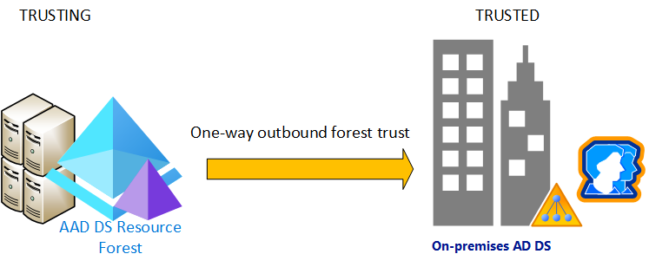
Azure AD Domain Services

Slide 17

Passthrough Authentication

Slide 18

Seamless Single Sign-On

Slide 19
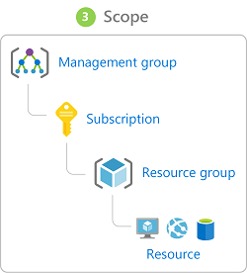
Azure Management Scopes
/ Tenant Root

Slide 20

Azure AD and Subscriptions

Slide 21
Infrastructure/Workload Design

Slide 22

VM High Availability

Slide 23

Web App High Availability

Slide 24
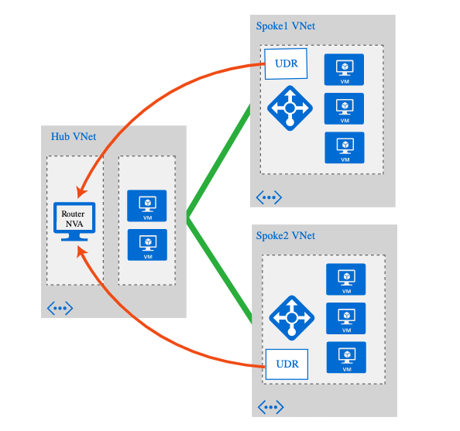
Hub and Spoke Networking

Slide 25
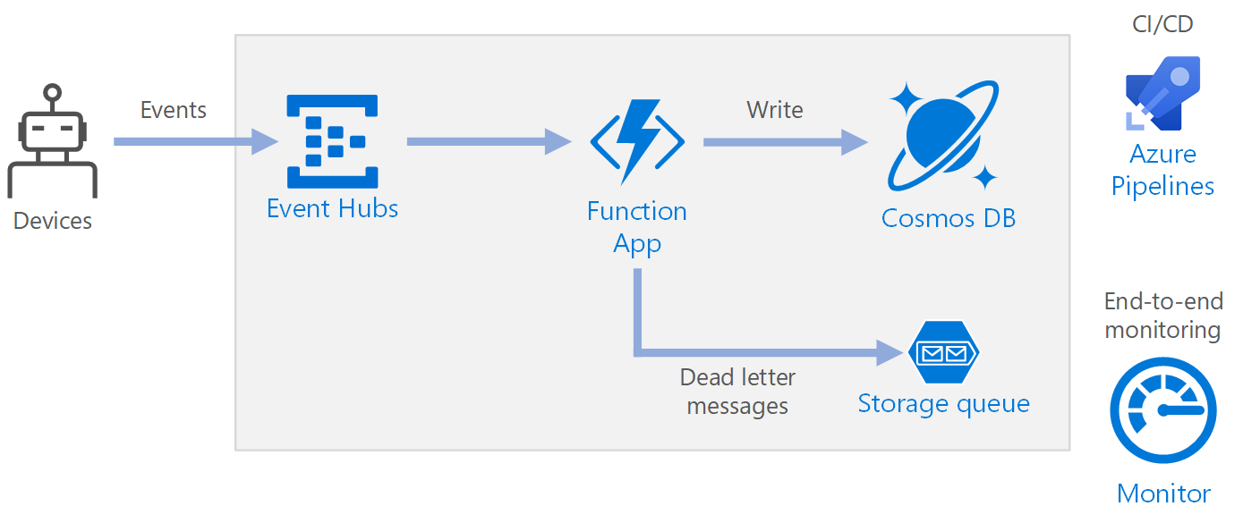
Azure Event Pipeline

Slide 26
Consumption, Auditing, Monitoring Design

Slide 27
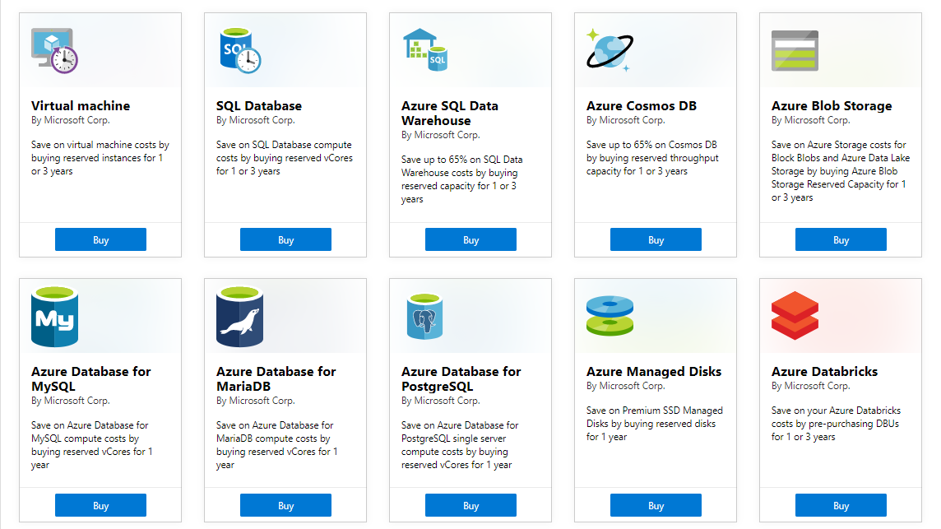
Azure Reservations

Slide 28
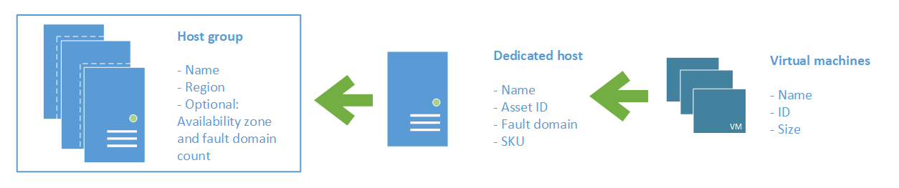
Azure Dedicated Host

Slide 29
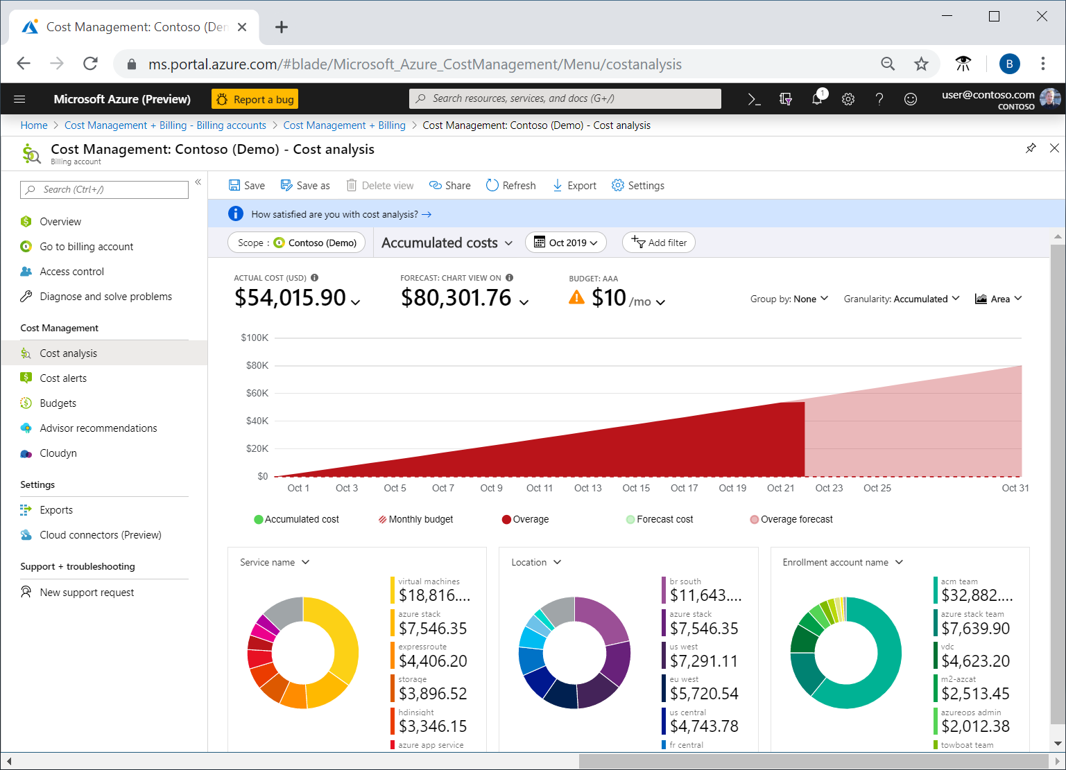
Azure Cost Analysis

Slide 30
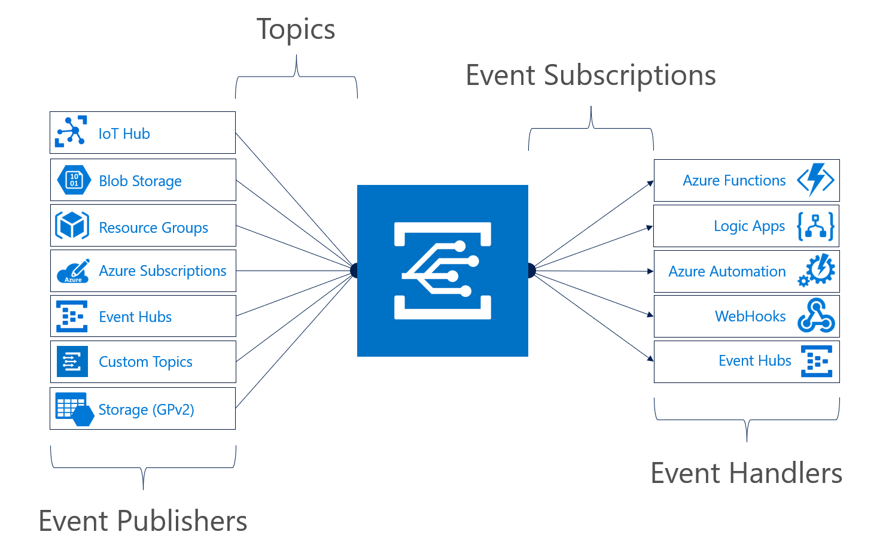
Azure Event Grid

Slide 31
Data Platform Solution Design

Slide 32

Availability Set

Slide 33

Availability Zone

Slide 34
Storage Account Replication
1
3
3
2
LRS
ZRS

Slide 35
Storage Account Replication
1
3
1
3
2
2
GRS – RA/GRS

Slide 36
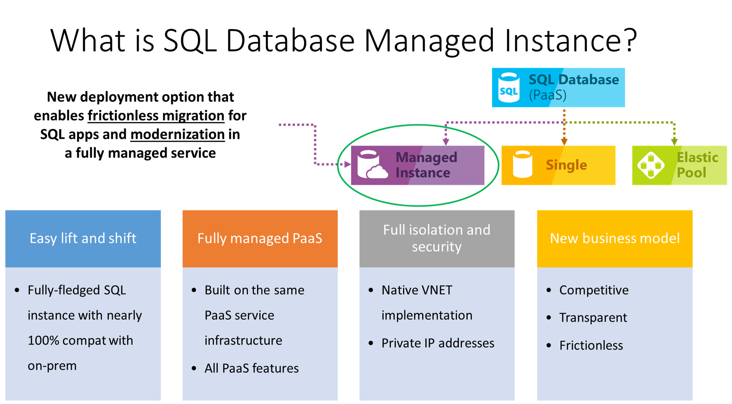

Slide 37
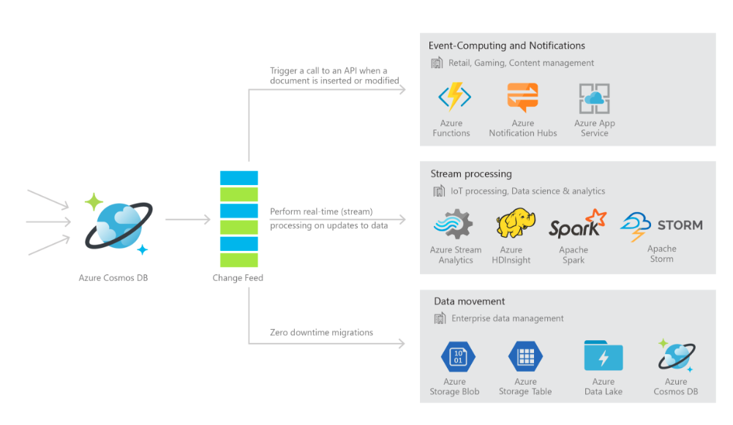
Cosmos DB

Slide 38

Always Encrypted

Slide 39
Business Continuity/High Availability Design

Slide 40
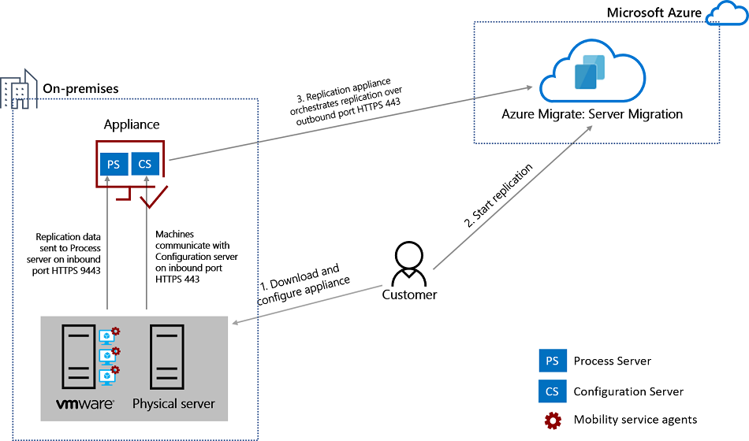
Azure Migrate

Slide 41
Exam AZ-301-304 Item Types

Slide 42

Single-Answer Multiple Choice

Slide 43
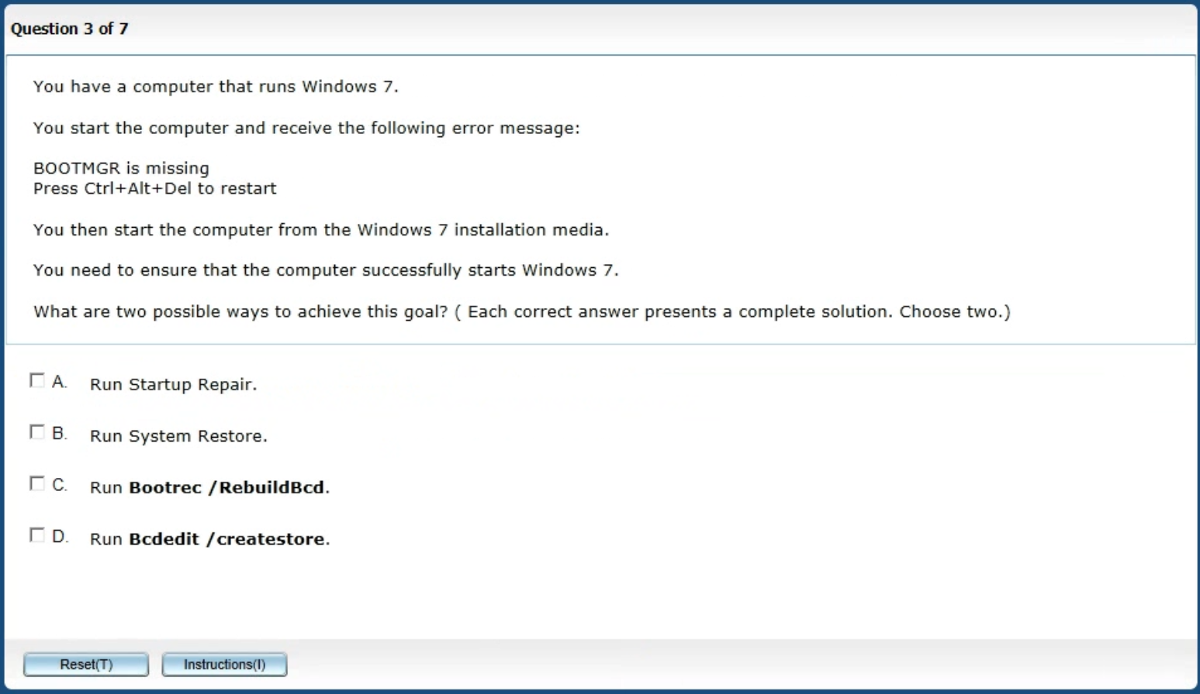
Multiple-Answer Multiple Choice

Slide 44
Repeated Scenario
You need to move an Azure VM to another hardware host.
Solution: You redeploy the VM.
Does this solution meet the goal?
Yes
No

Slide 45
Repeated Scenario
You need to move an Azure VM to another hardware host.
Solution: You restart the VM.
Does this solution meet the goal?
Yes
No

Slide 46

Select and Place

Slide 47

Build List and Reorder

Slide 48

Active Screen

Slide 49

Case Study

Slide 50
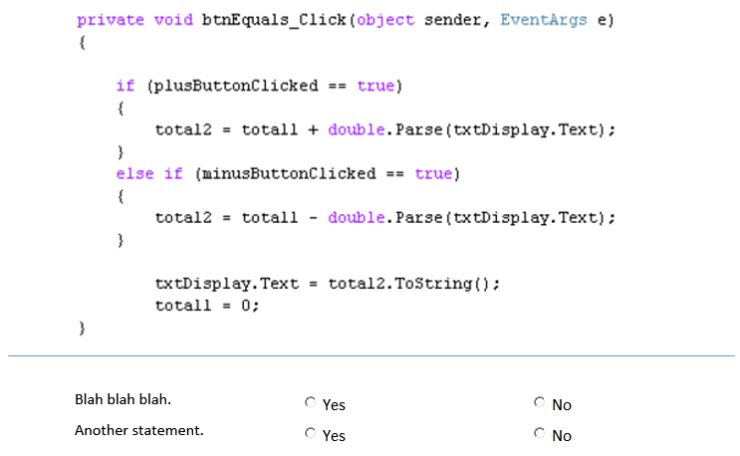
Statement / Code Analysis

Slide 51






Performance-Based Lab

Slide 52
Microsoft Online Testing

Slide 53

Microsoft Online Testing Process

Slide 54

Microsoft Online Testing Process

Slide 55

Microsoft Online Testing Process

Slide 56

Microsoft Online Testing Process

Slide 57

Microsoft Online Testing Process

Slide 58

Microsoft Online Testing Process

Slide 59

Microsoft Online Testing Process

Slide 60
AZ-301-304 Exam Strategy/Tips
Focus your skills accordingly:
60 percent Azure portal
20 percent Azure PowerShell
10 percent Azure CLI
10 percent KQL
Expect performance-based labs, and be surprised if you don't see 'em

Slide 61
Thank you!
Course materials: timw.info/az301
Twitter: @TechTrainerTim
Work: timw.info/ps
Web: TechTrainerTim.com

